Slide 1
Superstore Sales & Profitability Analysis Week 6 Capstone Project Git, GitHub & Final Data Analytics Project
Presented by: Nunna Bhuvana

Slide 2
Project Overview
This project analyzes the Superstore retail dataset to understand sales performance, profitability, customer segments, regional performance and product performance.
Objectives
Analyze sales and profit performance.
Identify high and low-performing products.
Compare regional and customer-segment performance.
Analyze sales trends over time.
Examine the relationship between discounts and profit.
Create an interactive Power BI dashboard.
Provide data-driven business recommendations.

Slide 3
Dataset
Superstore Dataset Final
Domain: Retail / Sales Analytics
Key Data Fields
Order and shipping dates
Customer information
Product information
Category and sub-category
Sales
Quantity
Discount
Profit
Region
Customer segment
Link: https://drive.google.com/file/d/10wuR5qiMwlymumdlI-Ib7KE5r9KsQtO9/view?usp=drive_link

Slide 4
Data Preparation
The dataset was prepared using Python and Pandas.
Data Preparation Steps
Inspected dataset structure and columns.
Checked data types.
Checked missing values.
Checked duplicate records.
Converted Order Date and Ship Date to datetime format.
Created Year and Month fields.
Created Year-Month for time-series analysis.
Created Shipping Days.
Checked numerical variables and unusual values.
Saved the cleaned dataset for further analysis.
Tools
Python
Pandas
NumPy
Google Colab

Slide 5
Overall Business Performance
KPI | Result
Total Sales | $2,297,200.86
Total Profit | $286,397.02
Total Orders | 5,009
Total Customers | 793
Total Quantity | 37,873
Profit Margin | 12.47%
Key Takeaway
The business generated approximately $2.30 million in sales and $286.4 thousand in profit, achieving an overall profit margin of 12.47%.

Slide 6
Key EDA Findings
Category Performance
Technology was the strongest category, generating:
Sales: $836,154.03
Profit: $145,454.95
Regional Performance
West was the strongest region:
Sales: $725,457.82
Profit: $108,418.45
Customer Segment
Consumer was the largest segment:
Sales: $1,161,401.34
Profit: $134,119.21

Slide 7
Product & Profitability Analysis
Most Profitable Sub-Category Copiers
Profit: $55,617.82
Other Strong Sub-Categories
Phones — $44,515.73 profit
Accessories — $41,936.64 profit
Paper — $34,053.57 profit
Major Concern
Tables generated $206,965.53 in sales but recorded a $17,725.48 loss.
Key Takeaway
High sales do not necessarily mean high profitability.

Slide 8
Power BI Dashboard
The interactive Power BI dashboard provides a consolidated view of Superstore performance.
Dashboard Components
Total Sales KPI
Total Profit KPI
Total Orders KPI
Profit Margin KPI
Sales by Category
Profit by Region
Monthly Sales Trend
Sales vs Profit
Profit by Sub-Category
Interactive Filters
Year
Region
Category
Segment

Slide 9
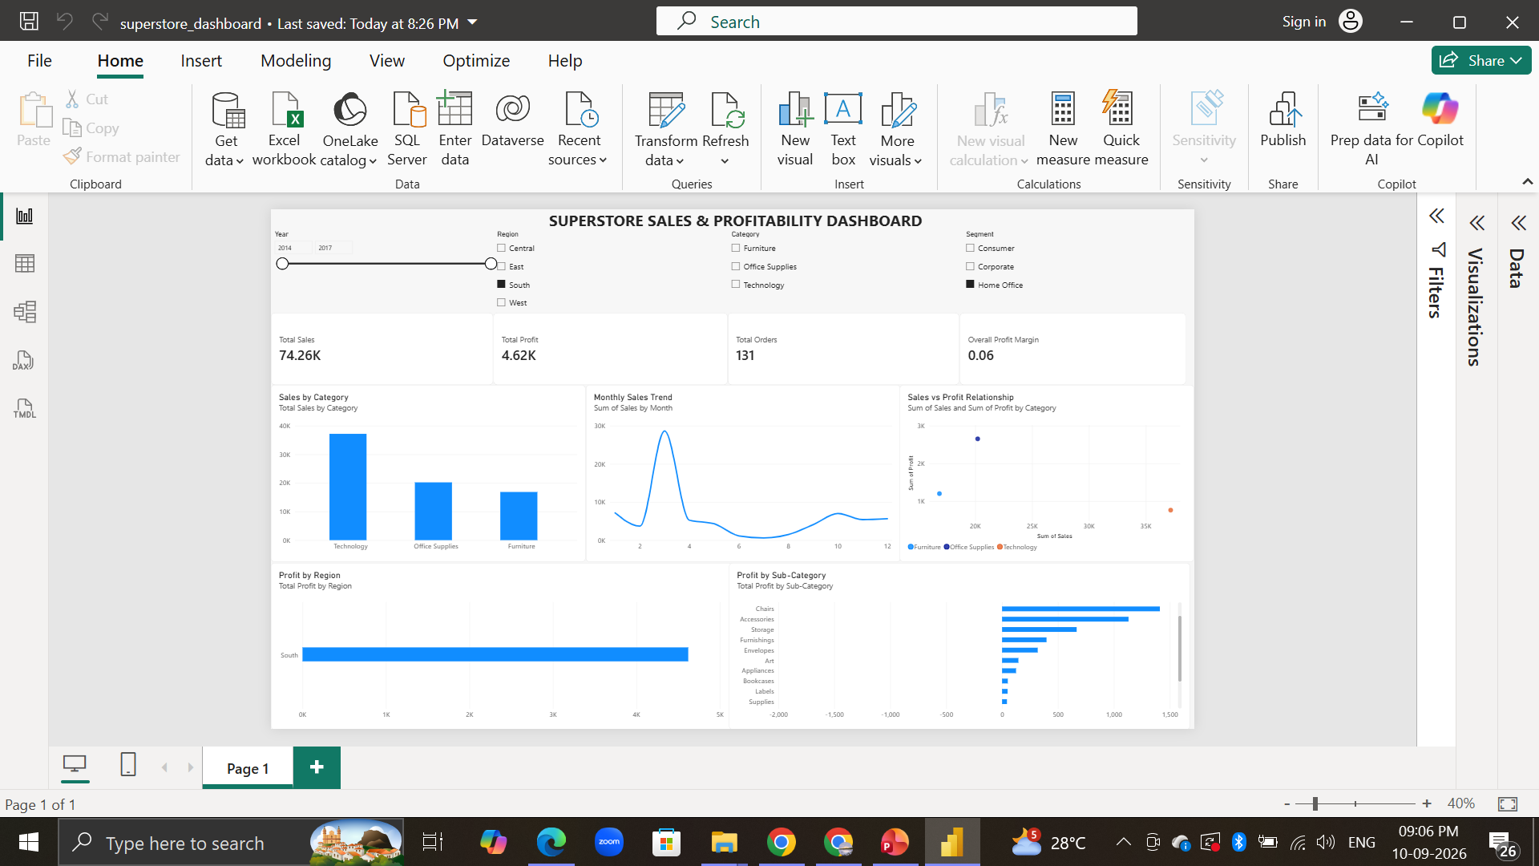
Power BI Dashboard

Slide 10
Business Insights & Recommendations
Key Insights
Technology is the strongest category by sales and profit.
West is the strongest region by sales and profit.
Copiers are the most profitable sub-category.
Tables and Bookcases require profitability investigation.
Consumer customers generate the highest sales and profit.
2017 recorded the highest annual sales.
Discount and profit have a weak negative correlation of -0.219.
Recommendations
1. Optimize pricing and discounts
Review discount levels and pricing for low-profit products.
2. Invest in high-performing areas
Continue supporting Technology, Copiers, Phones and Accessories.
3. Improve weaker regions
Investigate the causes of lower profitability in the Central region.

Slide 11
Conclusion
The Superstore analysis provides a detailed view of sales and profitability across products, categories, regions and customer segments.
Main Findings
$2.30M in total sales
$286.4K in total profit
12.47% profit margin
Technology was the strongest category.
West was the strongest region.
Consumer was the largest customer segment.
Some high-sales products had negative profitability.
Final Takeaway
Combining Python-based analysis with an interactive Power BI dashboard helps transform raw sales data into actionable business insights and supports better data-driven decision-making.

